Slide 1
Detecting Exoplanets and recovering Parameters
A short recap of my work in week 3v2

Slide 2
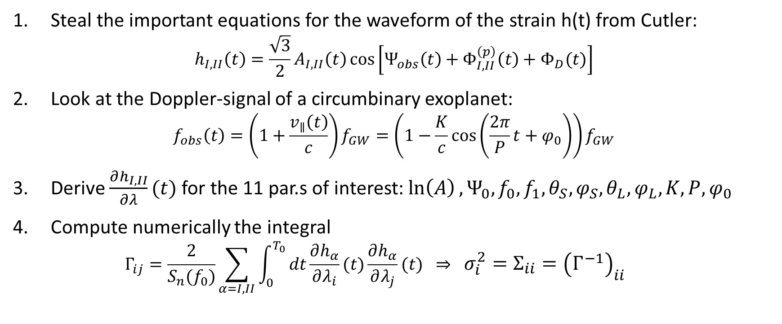
What did Tamanini and Danielski do?
Steal the important equations for the waveform of the strain h(t) from Cutler: $h_{I,II}\left(t\right)=\frac{\sqrt{3}}{2}A_{I,II}\left(t\right)\cos\left[Ψ_{obs}\left(t\right)+Φ_{I,II}^{\left(p\right)}\left(t\right)+Φ_{D}(t)\right]$
Look at the Doppler-signal of a circumbinary exoplanet: $f_{obs}\left(t\right)=\left(1+\frac{v_{∥}\left(t\right)}{c}\right)f_{GW}=\left(1−\frac{K}{c}\cos\left(\frac{2π}{P}t+φ_{0}\right)\right)f_{GW}$
Derive $\frac{∂h_{I,II}}{∂λ}(t)$ for the 11 par.s of interest: $\ln\left(A\right),Ψ_{0},f_{0},f_{1},θ_{S},φ_{S},θ_{L},φ_{L},K,P,φ_{0}$
Compute numerically the integral $Γ_{ij}=\frac{2}{S_{n}(f_{0})}\sum_{α=I,II}{\int_{0}^{T_{0}}{dt\frac{∂h_{α}}{∂λ_{i}}(t)\frac{∂h_{α}}{∂λ_{j}}(t)} } ⇒ σ_{i}^{2}=Σ_{ii}={\left(Γ^{−1}\right)}_{ii}$

Slide 3
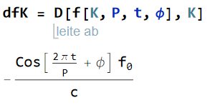
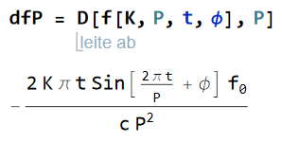
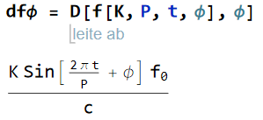
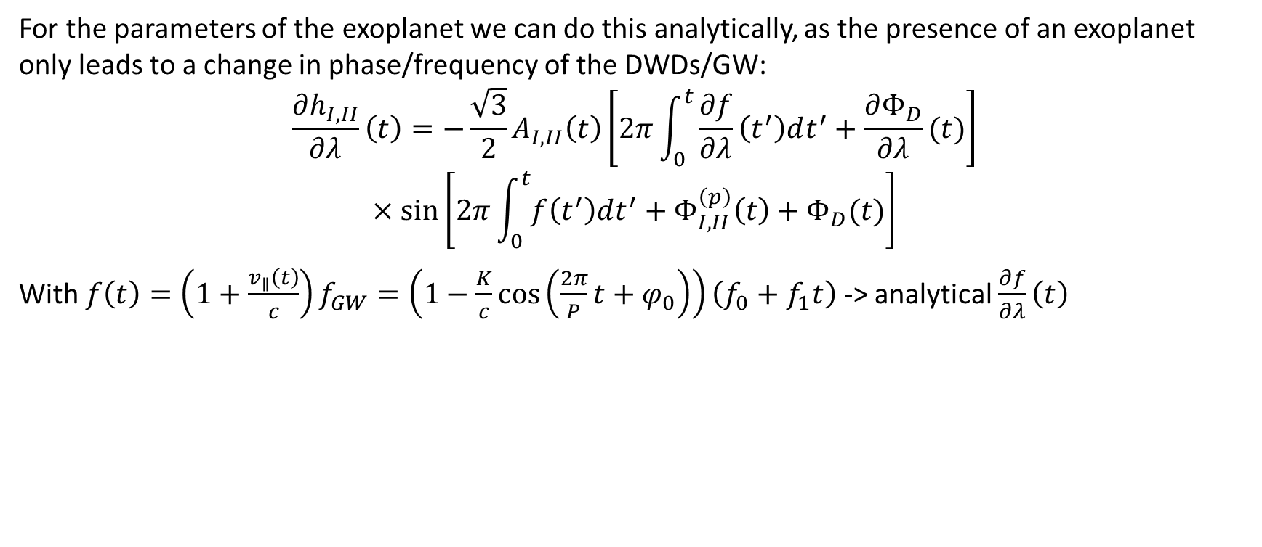
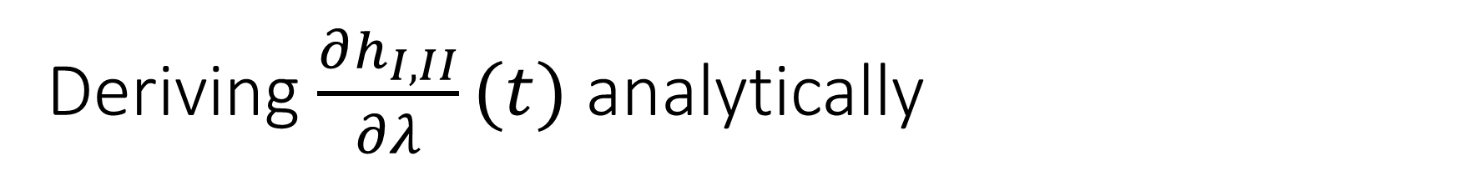
Deriving $\frac{∂h_{I,II}}{∂λ}(t)$ analytically
For the parameters of the exoplanet we can do this analytically, as the presence of an exoplanet only leads to a change in phase/frequency of the DWDs/GW:
$$\frac{∂h_{I,II}}{∂λ}\left(t\right)=−\frac{\sqrt{3}}{2}A_{I,II}\left(t\right)\left[2π\int_{0}^{t}{\frac{∂f}{∂λ}\left(t^{′}\right)dt^{′}}+\frac{∂Φ_{D}}{∂λ}(t)\right]$$
$$×\sin\left[2π\int_{0}^{t}{f\left(t^{′}\right)dt^{′}}+Φ_{I,II}^{\left(p\right)}\left(t\right)+Φ_{D}(t)\right]$$
With $f\left(t\right)=\left(1+\frac{v_{∥}\left(t\right)}{c}\right)f_{GW}=\left(1−\frac{K}{c}\cos\left(\frac{2π}{P}t+φ_{0}\right)\right)\left(f_{0}+f_{1}t\right)$ -> analytical $\frac{∂f}{∂λ}\left(t\right)$

Slide 4
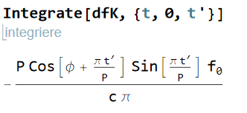
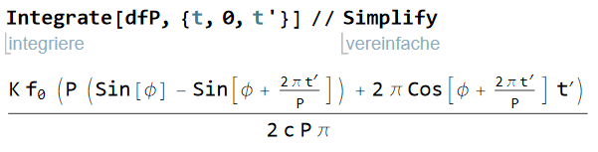
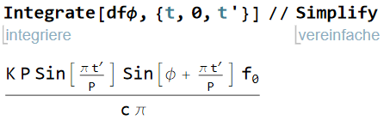
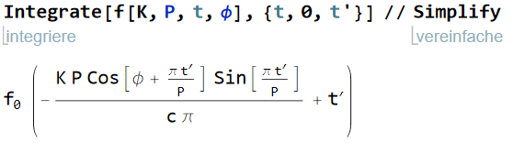

And we can also do $2π\int_{0}^{t}{\frac{∂f}{∂λ}\left(t^{′}\right)dt^{′}}$

Slide 5
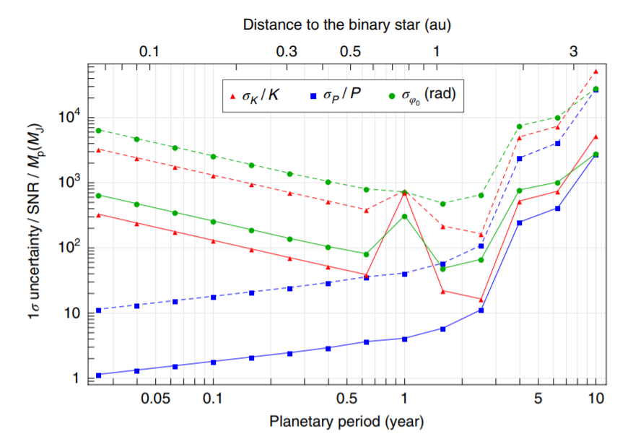
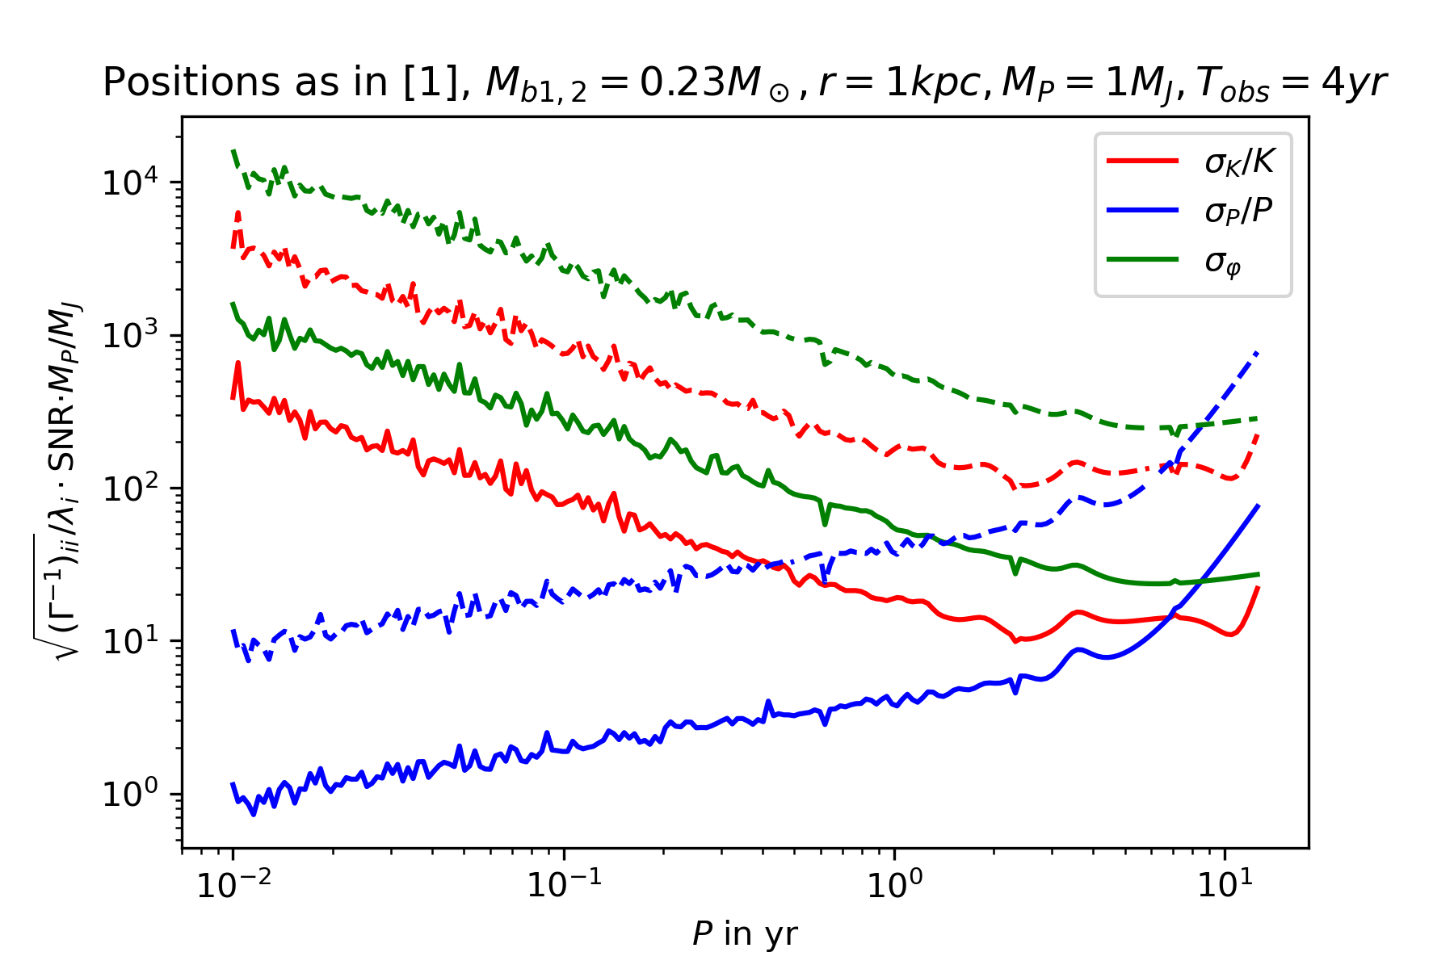
Computing the uncertainties approximately
It‘s quite similiar, but: It‘s not the same! There are some missing steps
Note #1: Wigliness probably due to floating point errors in integration + matrix inversion
Note #2: Different amplitude because Tamanini, Danielski took SNR approximately

Slide 6
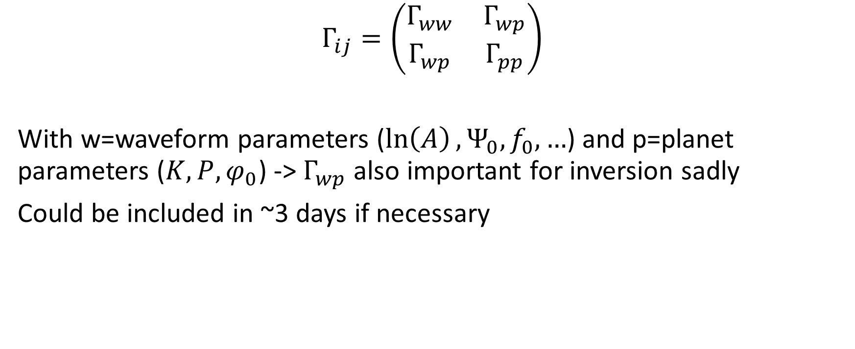
Missing steps
$$Γ_{ij}=\left(\begin{matrix}Γ_{ww} & Γ_{wp} \\ Γ_{wp} & Γ_{pp}\end{matrix}\right)$$
With w=waveform parameters ($\ln\left(A\right),Ψ_{0},f_{0},…$) and p=planet parameters ($K,P,φ_{0}$) -> $Γ_{wp}$ also important for inversion sadly
Could be included in ~3 days if necessary

